Slide 1

Team 7: Lochinvar Fan Simulator

Slide 2

Fan Simulator
Tucker Basham
Jacob Brewer
Ethan Haynes
Conner Vick
Layne Bowman

Slide 3
Agenda
Problem Formulation and Background
Standards and Regulations
Broader Impacts
Tool Specifications
Design
Implementation and Issues Overcame
Software
Experimentation
Demo

Slide 4
Problem Formulation
Testing commercial and residential boiler fans presents its challenges—namely, the noise generated. To address these issues, Lochinvar tasked us with creating a diagnostic tool that simulates a realistic fan, eliminating unnecessary noise and allowing for multiple use cases with a singular tool.

Slide 5
Stakeholder Identification
The identified stakeholders for the diagnostic tool are Lochinvar and their parent company A.O Smith.
The problem stems from Lochinvar’s need to test their boiler systems.
Testing involves edge cases, lockout testing, stress condition testing, and standard diagnostic runs.

Slide 6
Standards and Regulations
IPC-2221: This standard outlines how PCBs should be designed to ensure reliability, quality, and safety.
IPC J-STD-001: This standard is known as the "Requirements for Soldered Electrical and Electronic Assemblies". It correlates to the following key elements:
Materials and Equipment used
Solder Processes and Procedures (Such as hand soldering)
Workmanship and Inspection Criteria
Training and Certification
IEC 61010-2-081: The IEC 61010 standard is for the safety requirements for electrical equipment for measurement, control, and laboratory use. The specific subsection that we will need to follow is subsection 2-081. This subsection applies to automatic and semi-automatic laboratory equipment for analysis and other purposes. In other words, this section pertains to equipment for measuring or modifying one or more characteristics or parameters of samples.

Slide 7
Broader impacts
Our diagnostic tool enhances workplace efficiency by reducing the time needed to test and evaluate boiler controls and fans.
This improvement primarily enhances the diagnostic process by helping to streamline testing and troubleshooting of fan and control systems.
Additionally, the tool establishes a solid baseline product that can be further customized with additional modes for various applications.

Slide 8
Tool Specifications
The diagnostic tool shall have the hardware to accomplish the Fan Simulation Mode, the Fan Driving Mode, and the Monitoring Mode.
The diagnostic tool shall allow the user to select one of the three modes, only the Fan Simulation mode will be functional.
The diagnostic tool shall have an LCD screen that will display the PWM signal, tachometer signal, and user interface .
The diagnostic tool will have buttons for the user to adjust which mode and/or the parameters for that mode.

Slide 9
Conceptual Solution Overview
Subsystems
Power
Microcontroller
Interface
Memory
Pre-Processing
Post-Processing
Case & Ports and Buttons

Slide 10
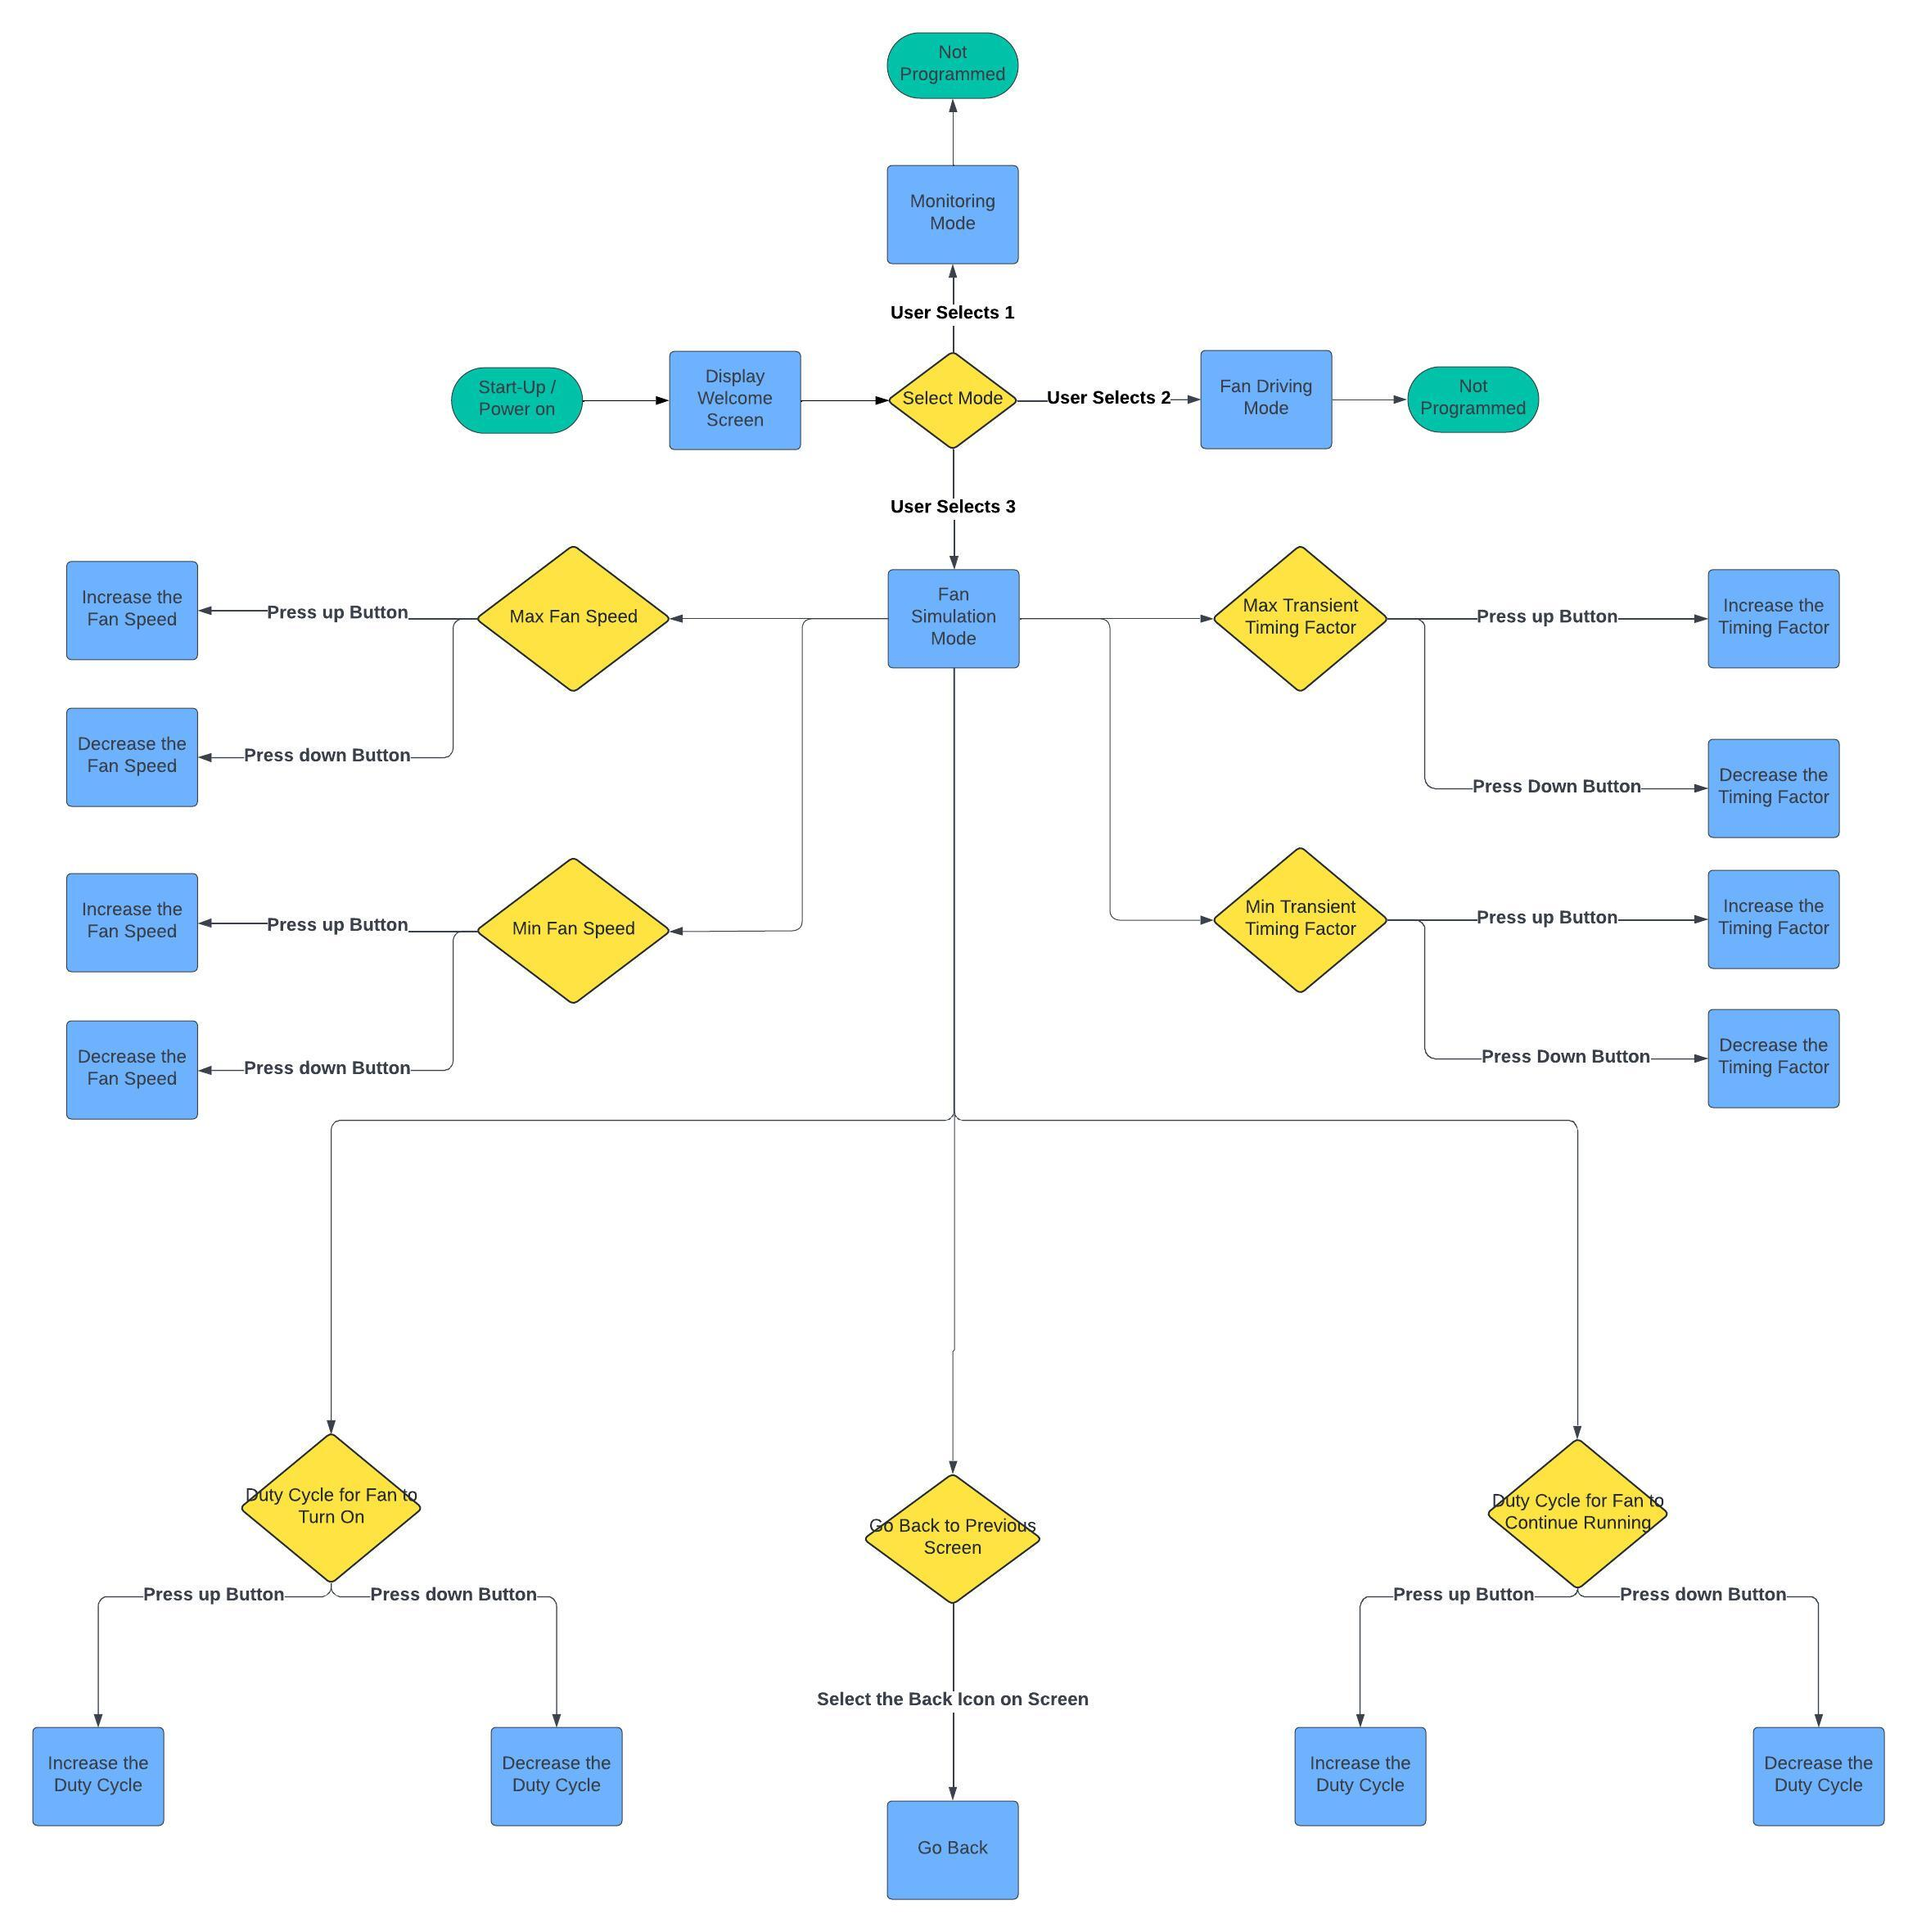
Operational Flow Chart

Slide 11
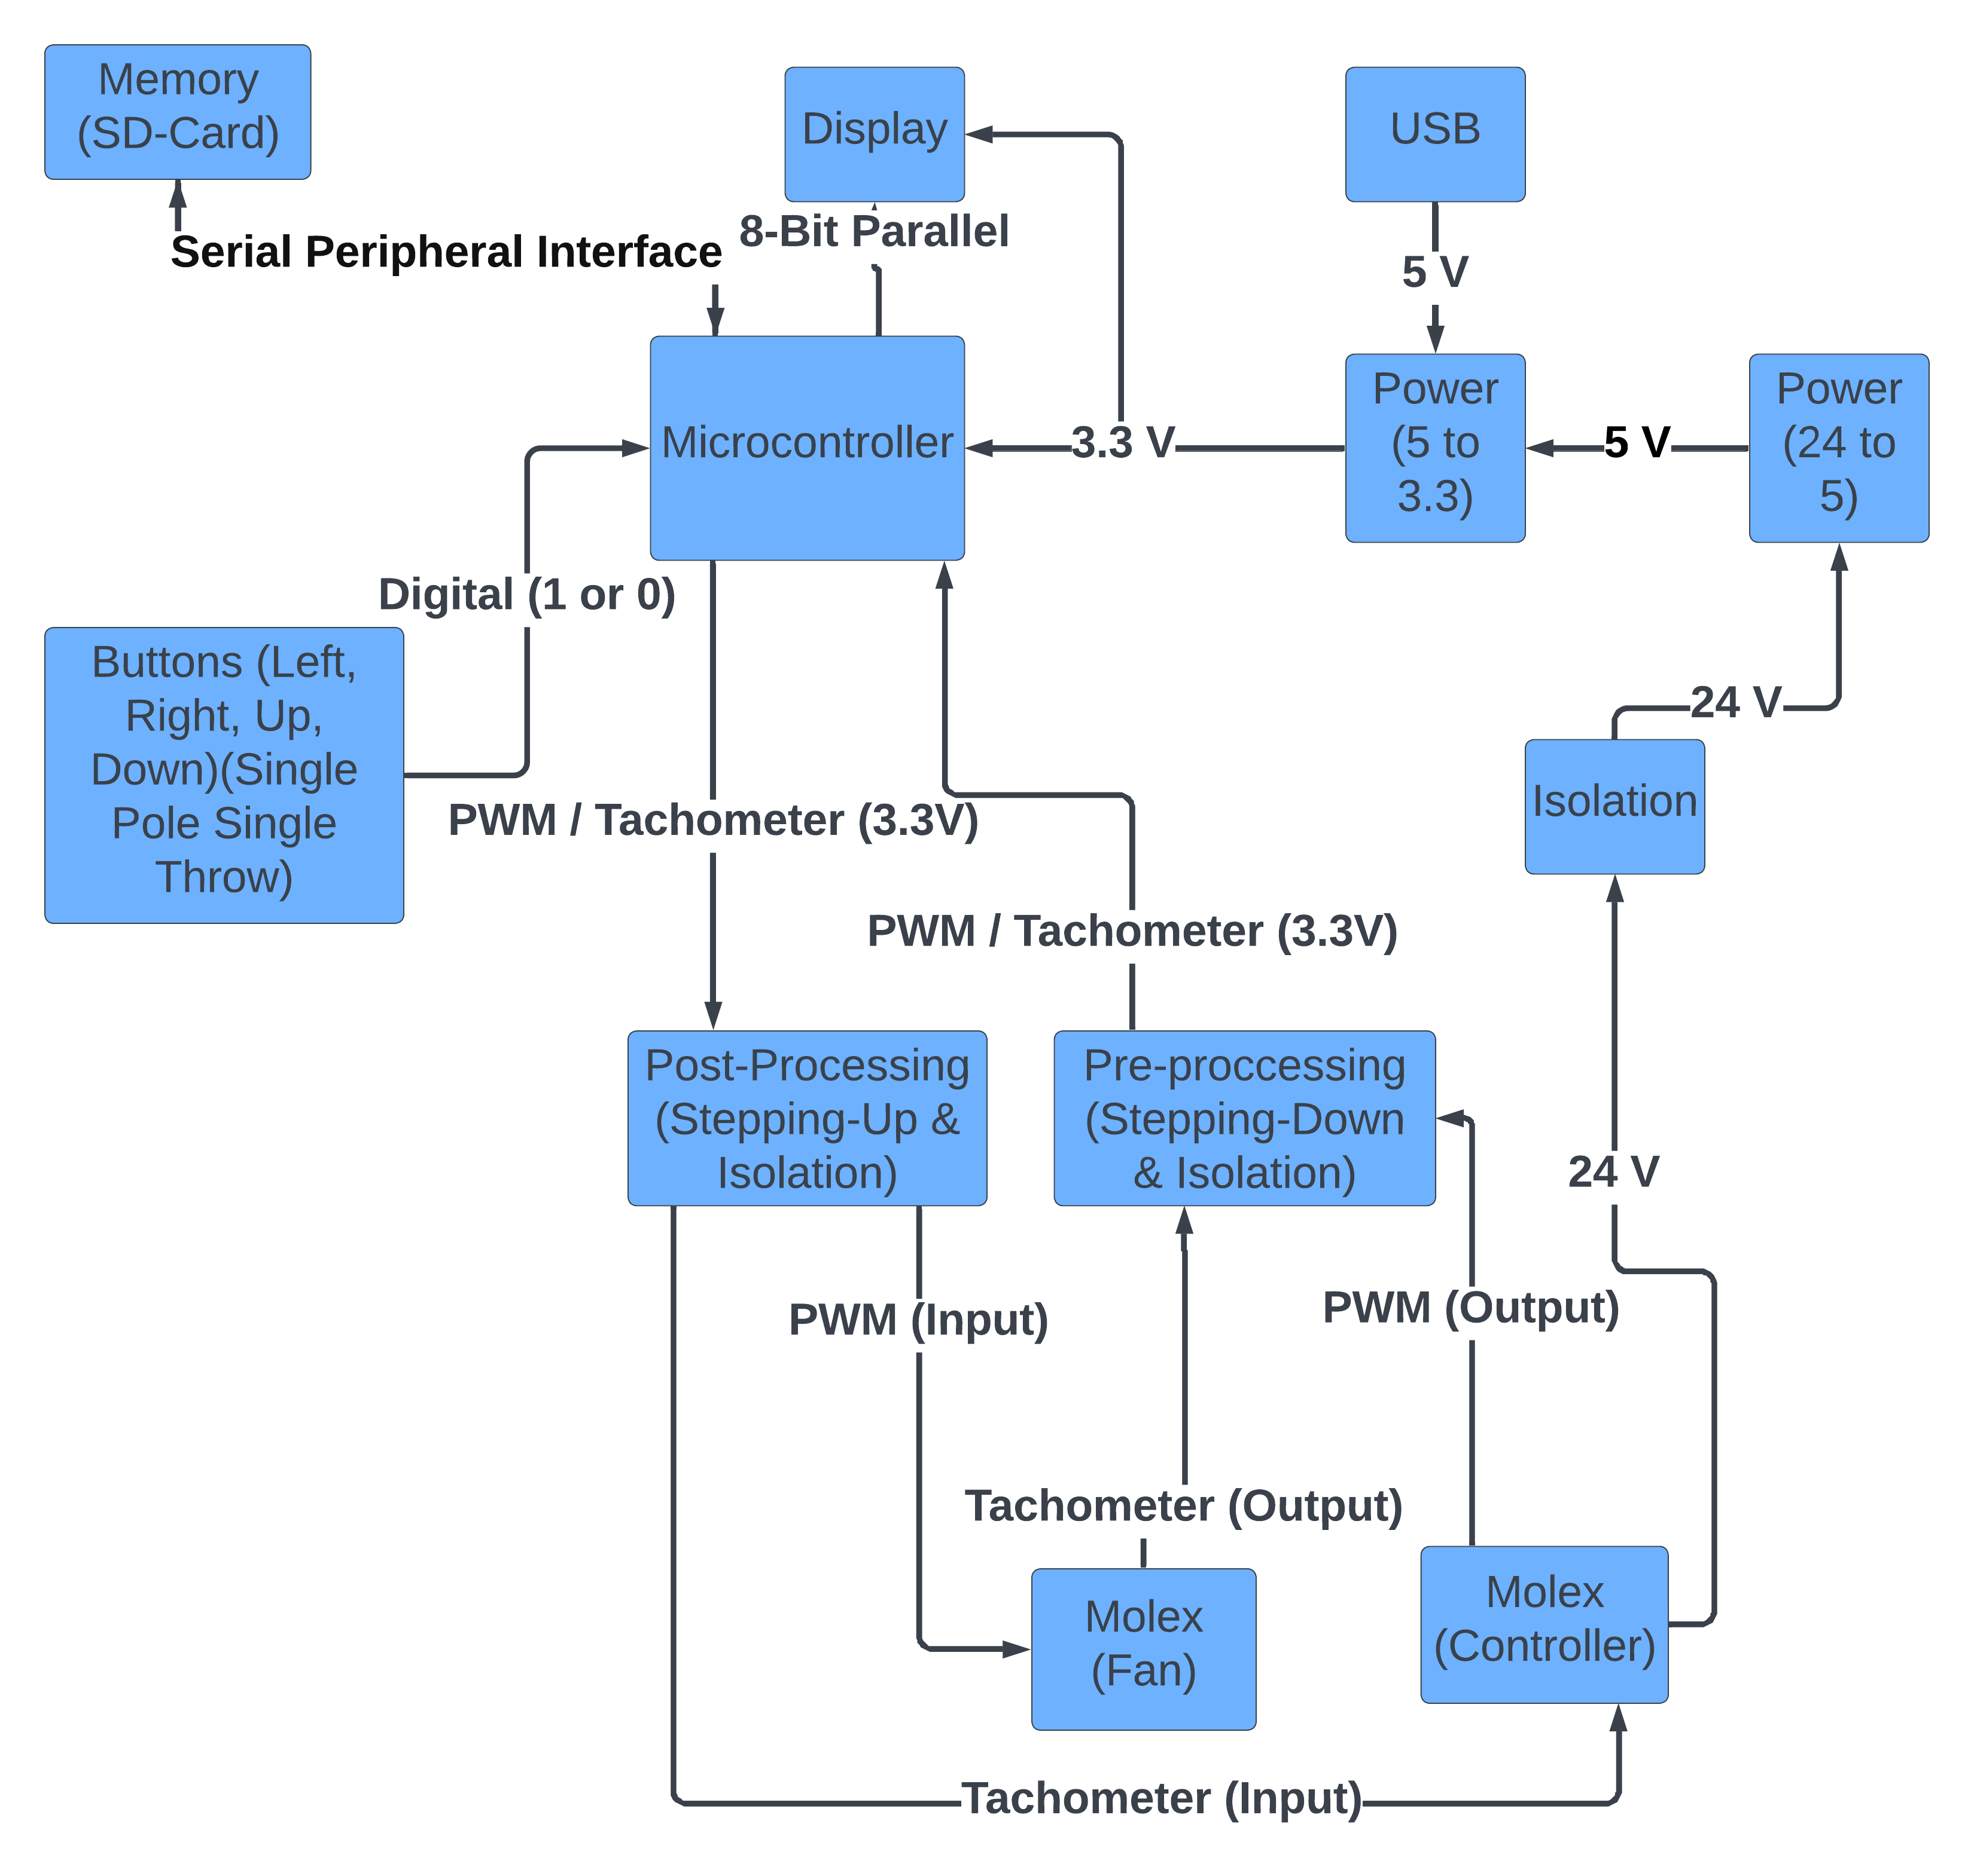
Hardware Block Diagram

Slide 12
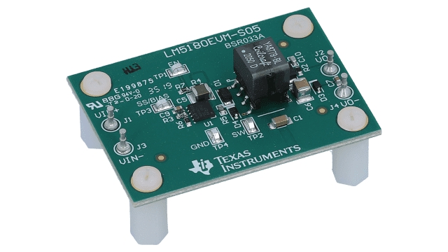
Power
A flyback converter was chosen for electrical isolation and stepping down voltage for the microcontroller.

Slide 13
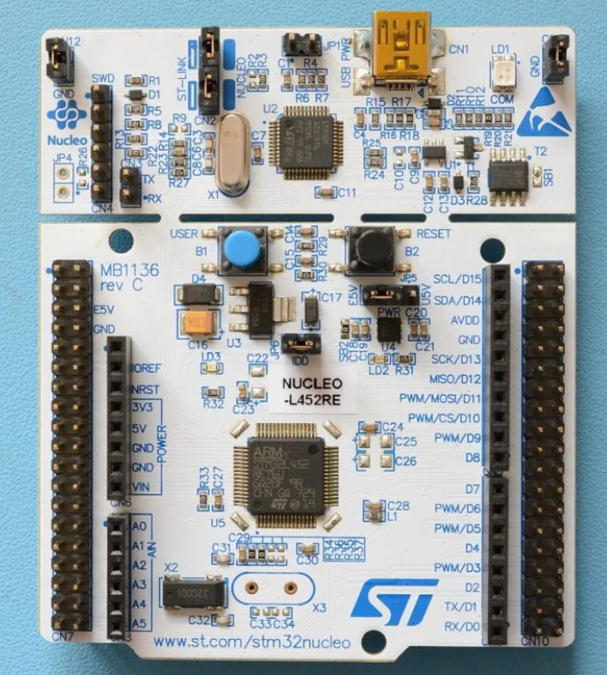
Microcontroller
A STM-Nucleo32 developmental board was chosen as the microcontroller due to familiarity, channel options, and ease of implementation.

Slide 14
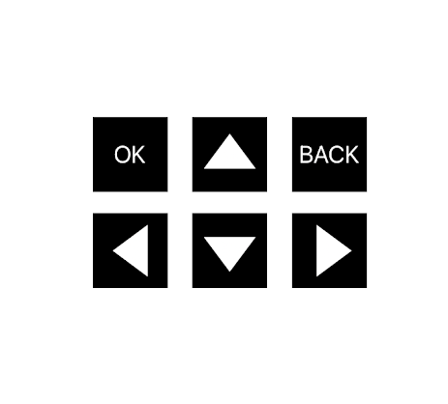
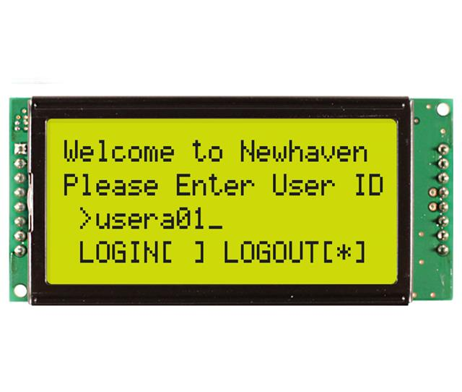
Interface
A 4 by 20 character LCD was chosen due to the amount of information needed to be seen at any given time.
The number of buttons was chosen with usability in mind

Slide 15
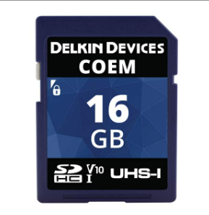
Memory
Standard 16GB SD card using FATFS functions.

Slide 16
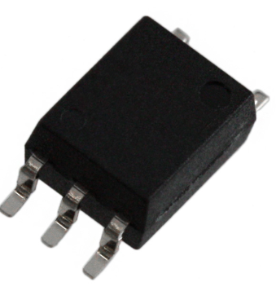
Pre/Post Processing
Opto-couplers were chosen due to the need for isolation on either end of the microcontroller.

Slide 17
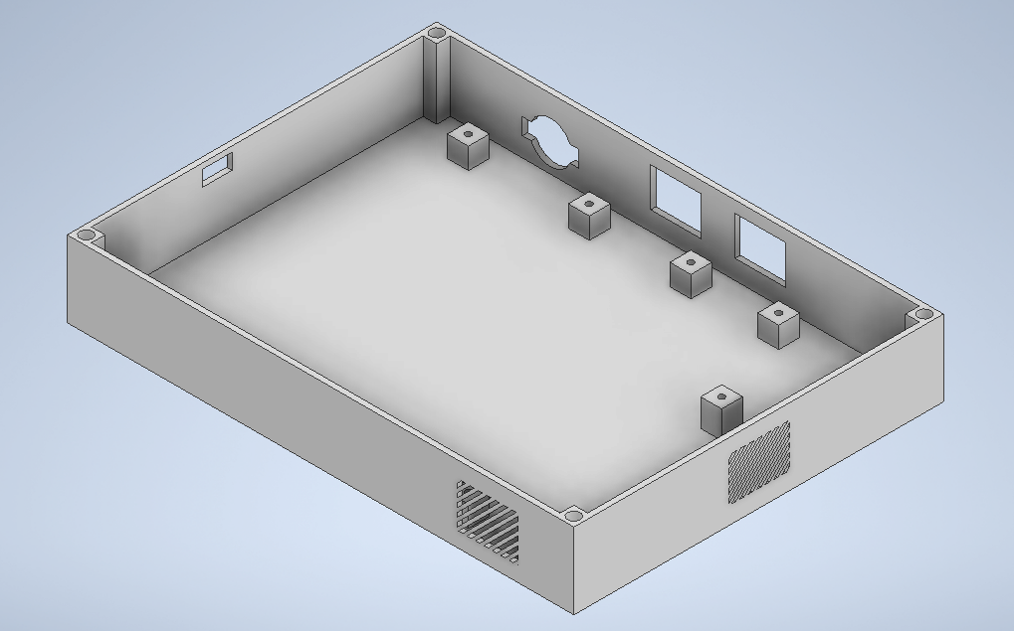
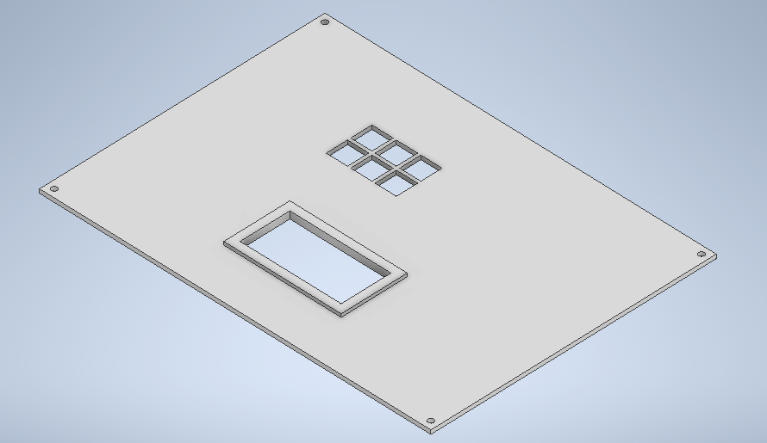
Case

Slide 18
Implementation
Build Phase
Testing Phase
Doomsday

Slide 19
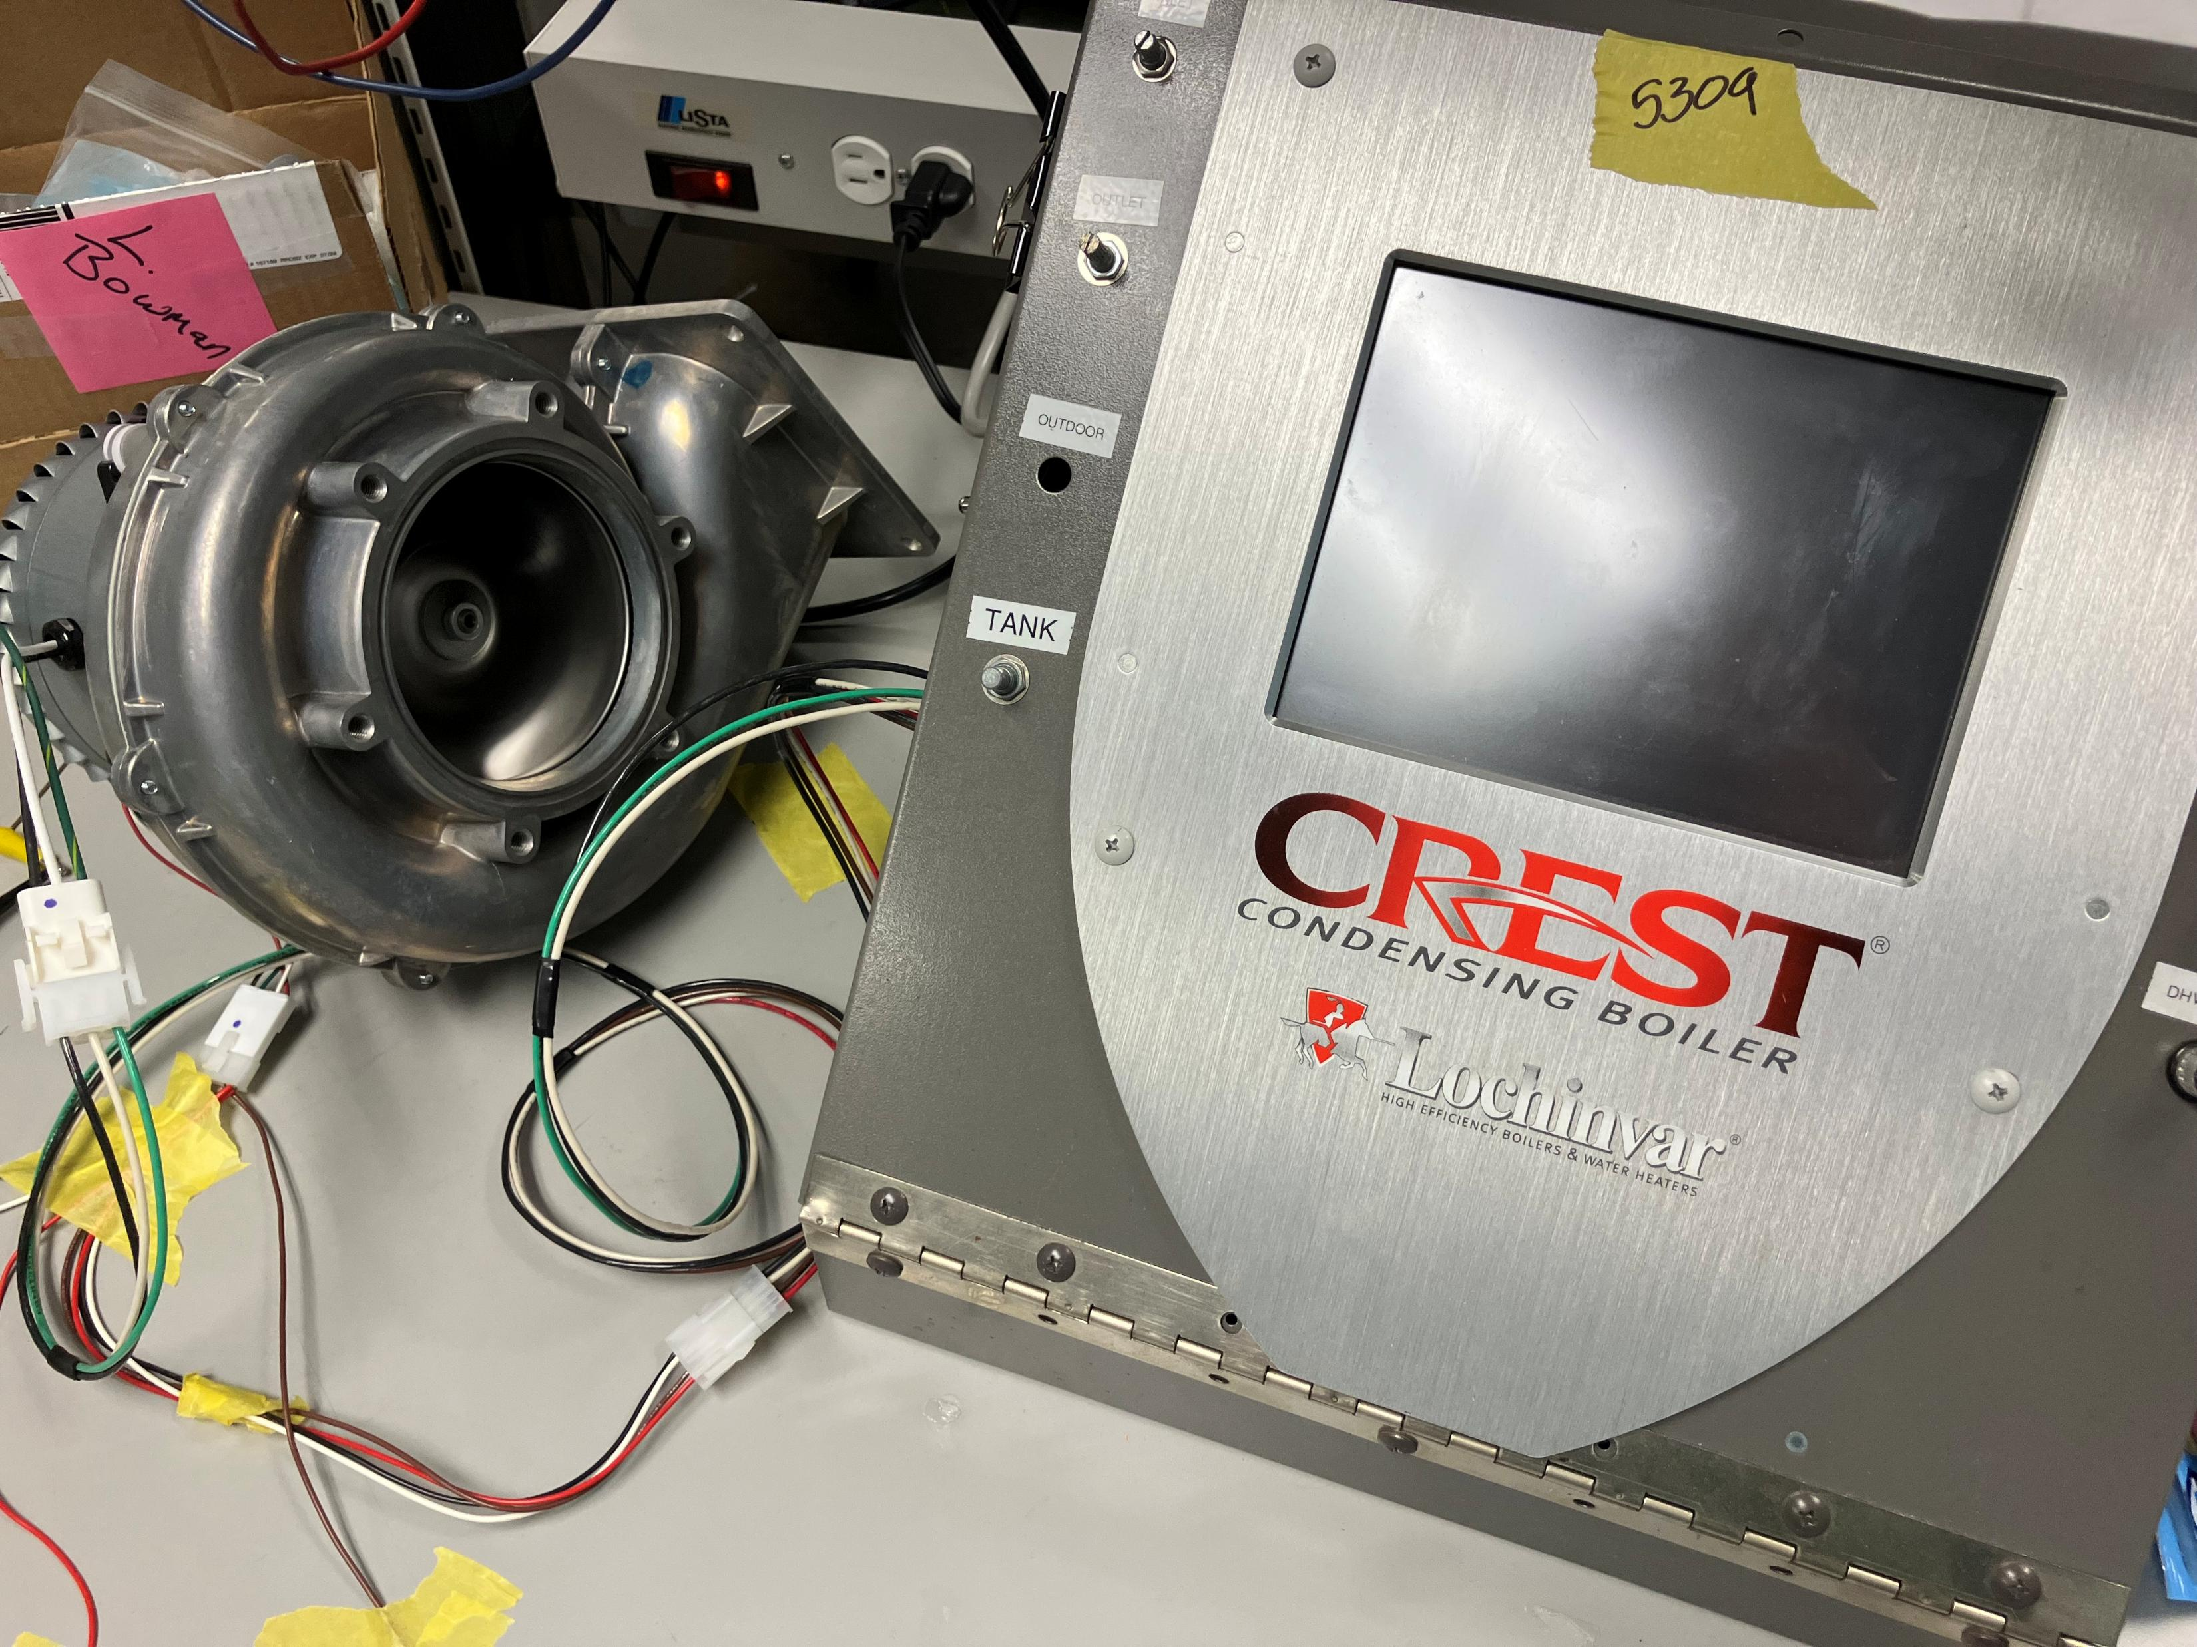
Doomsday

Slide 20
Issues Overcame
Opto-Coupler Circuit
Control Board Issues
Upside Down LCD
Timer Channel Configuration Issues

Slide 21
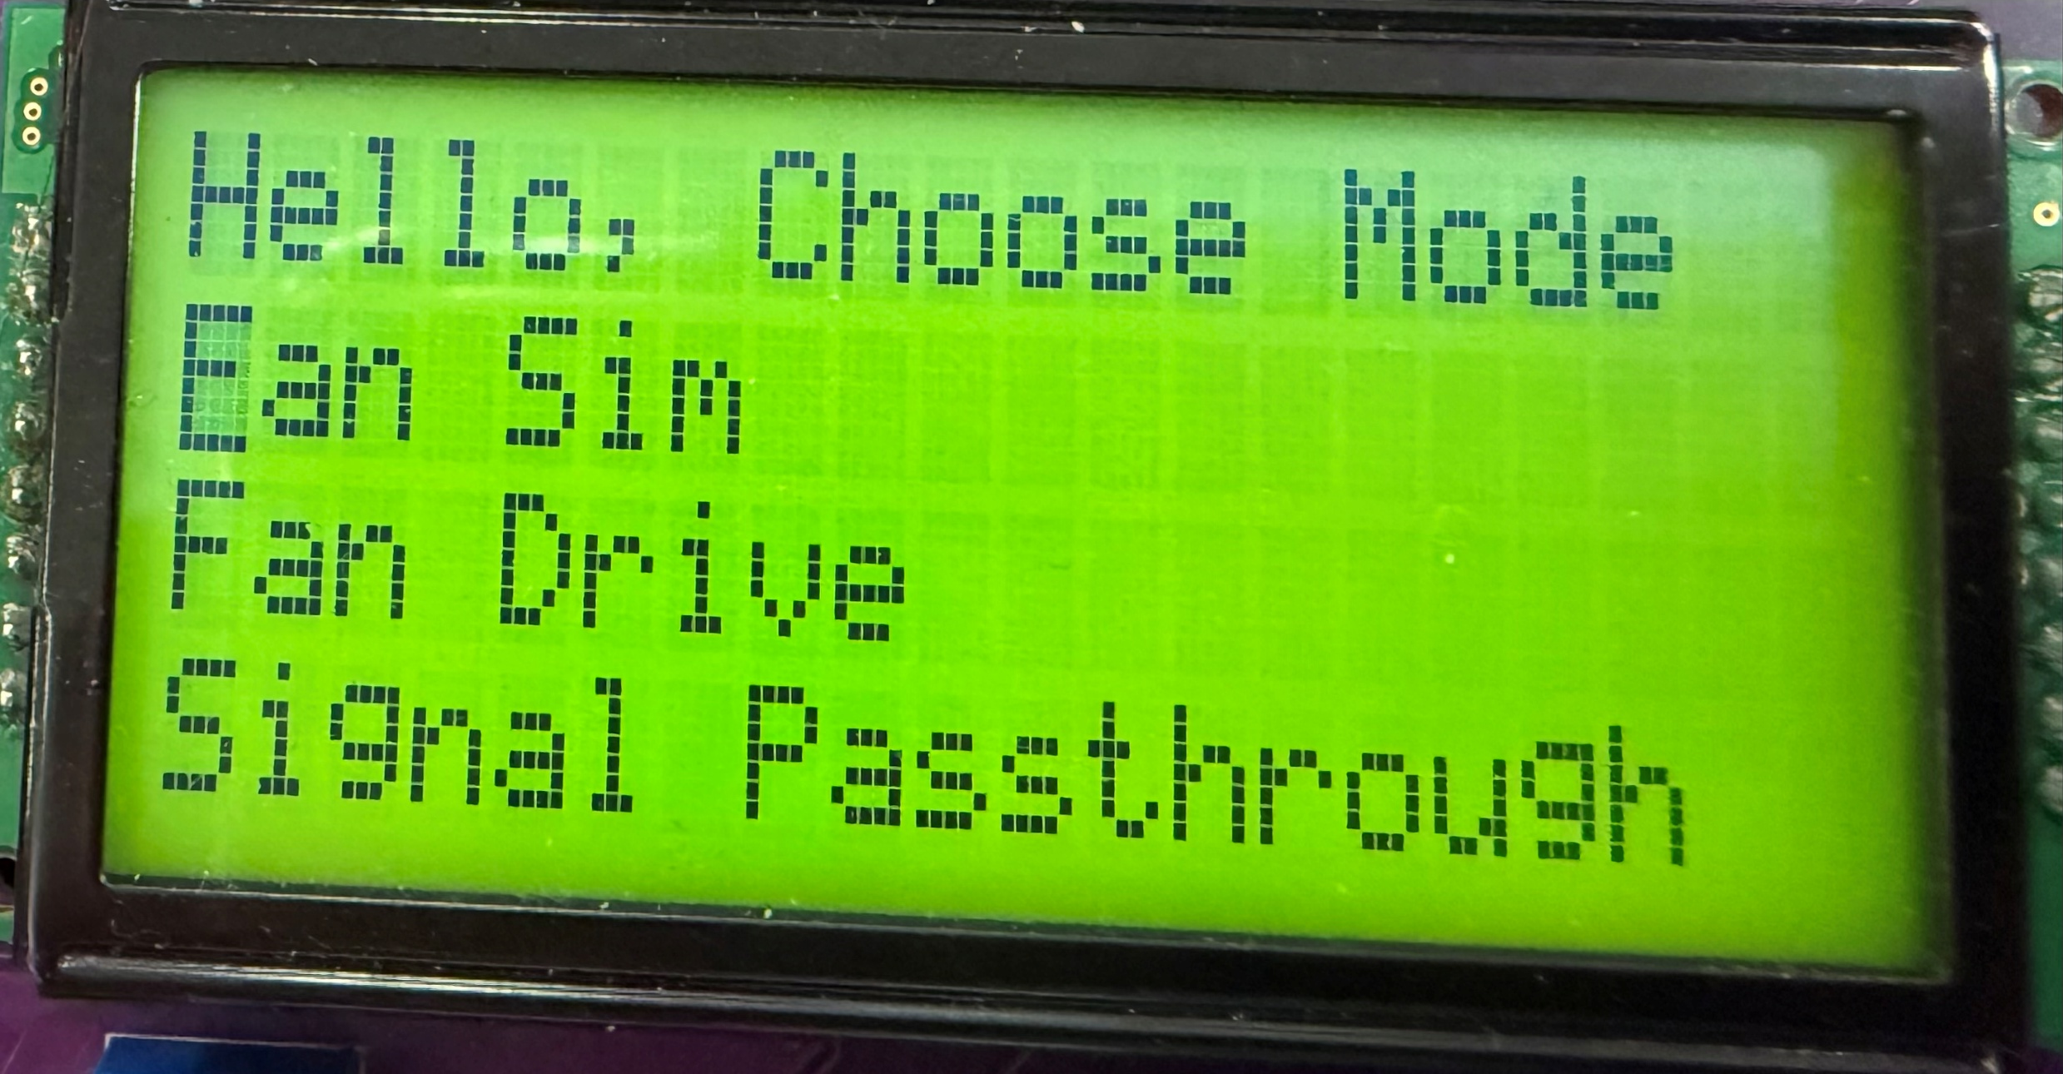
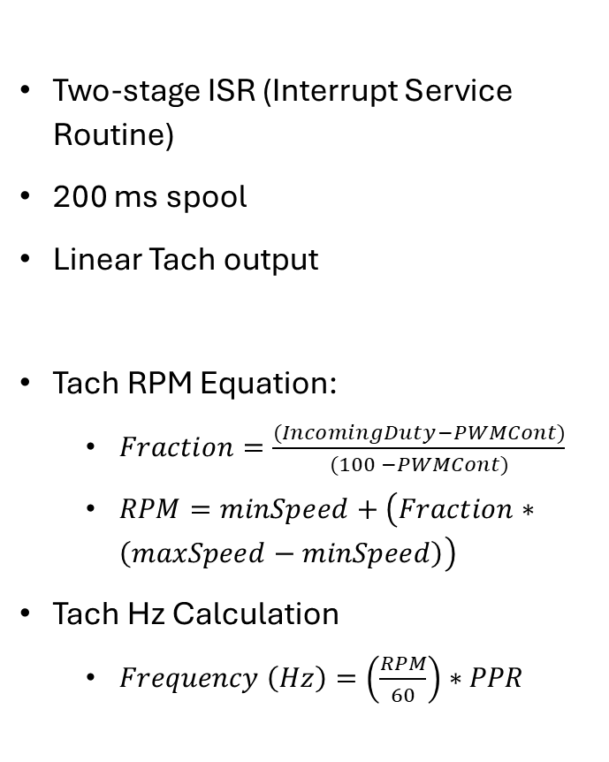
Software
Two-stage ISR (Interrupt Service Routine)
200 ms spool
Linear Tach output
Tach RPM Equation:
$Fraction=\frac{(IncomingDuty−PWMCont)}{(100 −PWMCont)}$
$RPM=minSpeed+\left(Fraction∗\left(maxSpeed−minSpeed\right)\right)$
Tach Hz Calculation
$Frequency \left(Hz\right)=\left(\frac{RPM}{60}\right)∗PPR$

Slide 22
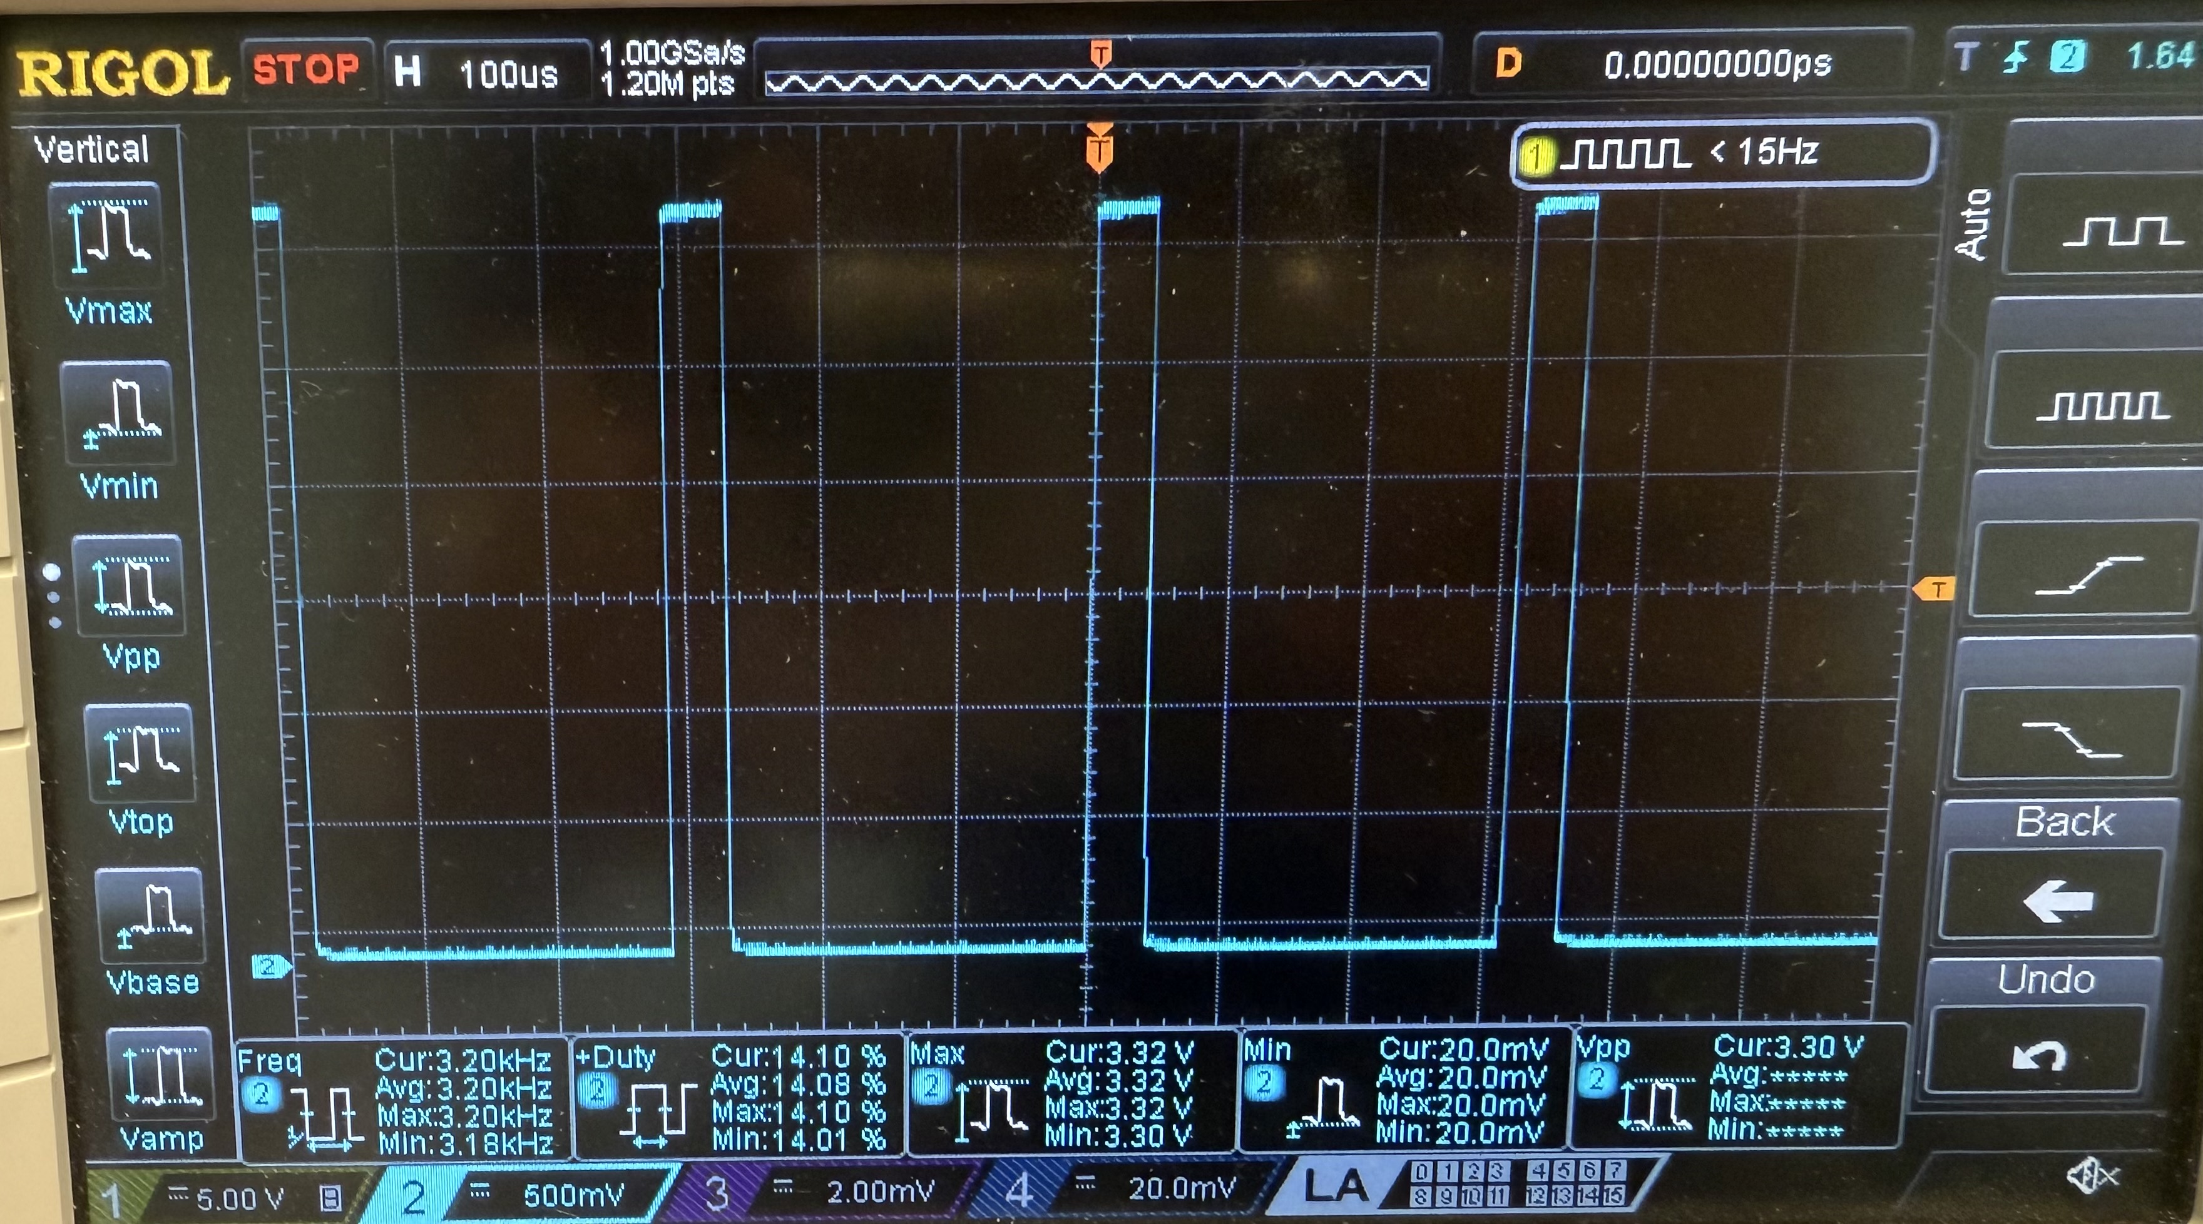
Experimentation
PWM signal that the Lochinvar Control Board is generating.

Slide 23
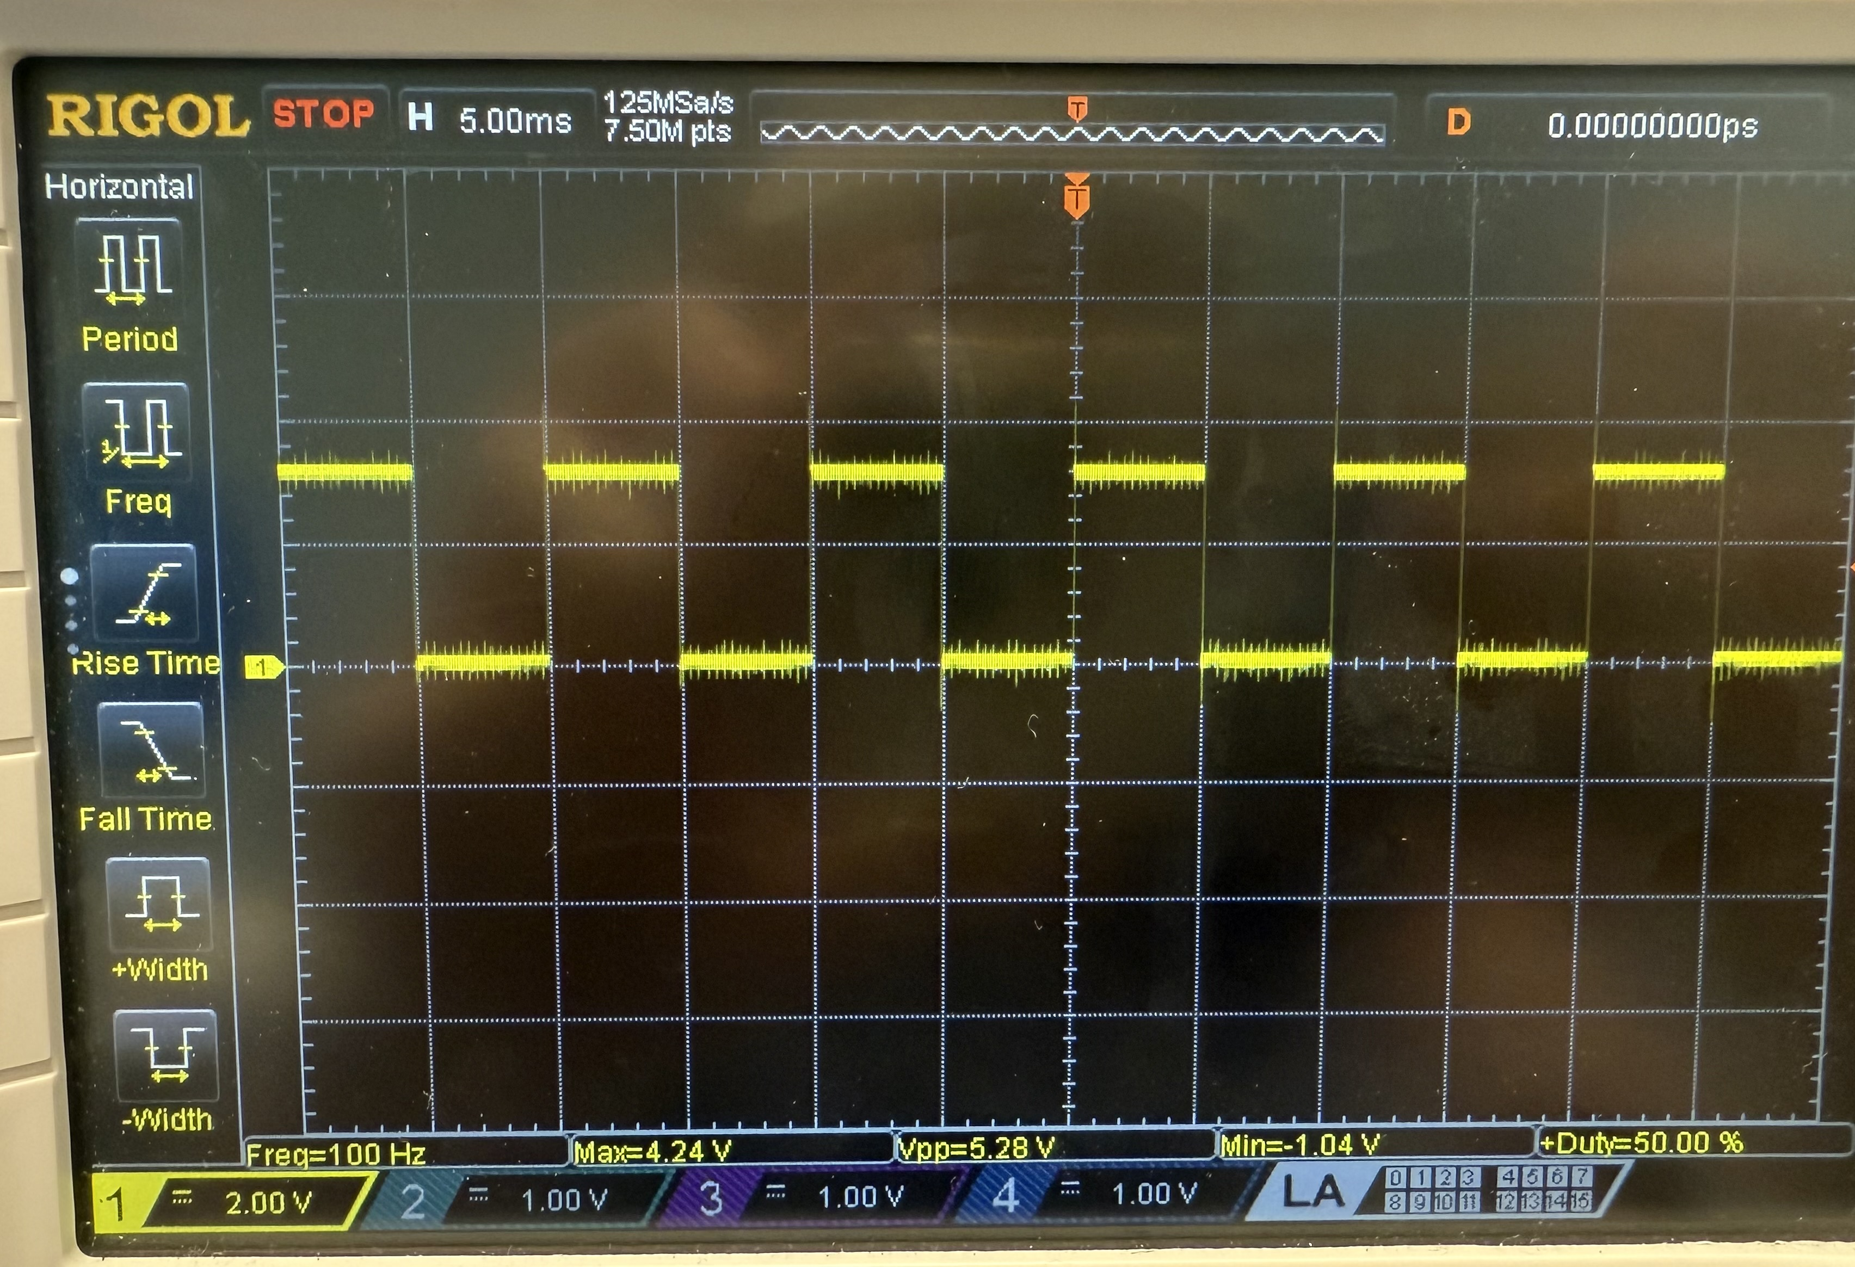
Experimentation
Tachometer signal that has been generated from our tool.

Slide 24
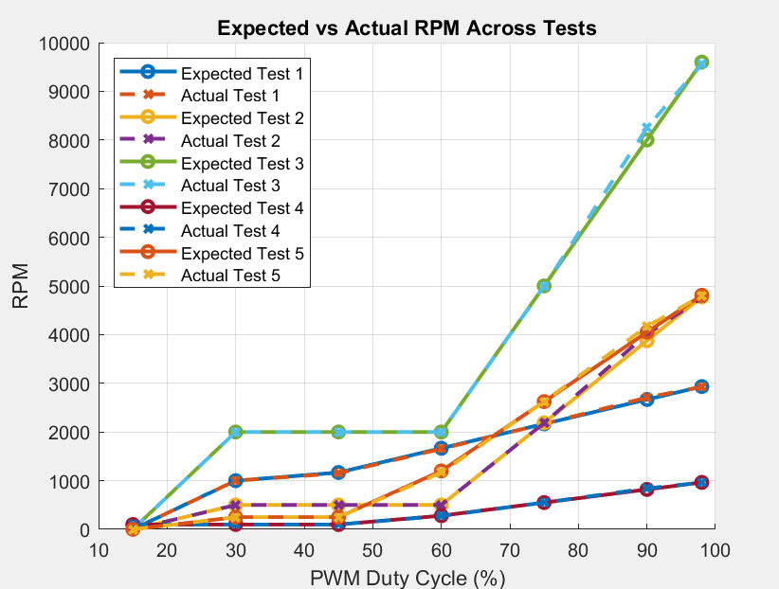
Experimentation

Slide 25
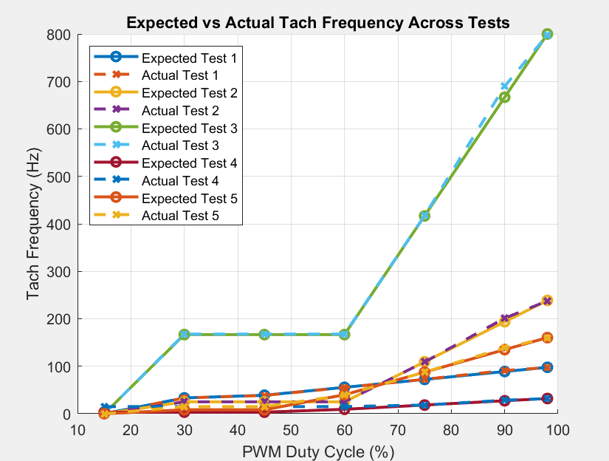
Experimentation

Slide 26
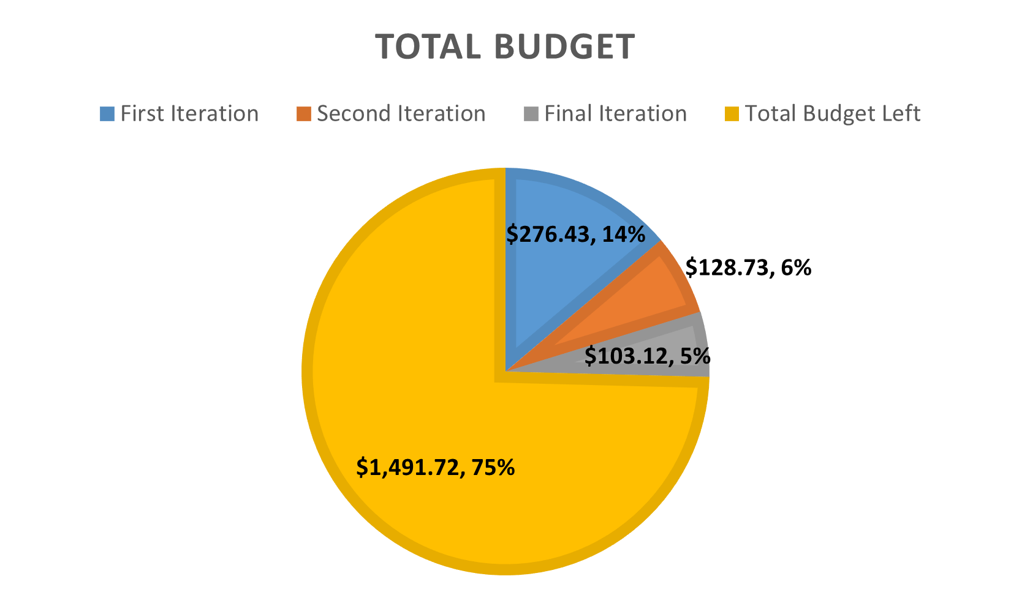

Slide 27
Demonstration
Demo has been removed from the PowerPoint to reduce the size of the file. This will allow the file to be uploaded to the Github.

Slide 28
Lessons Learned
Buy things during the design phase to have a better first revision.
Work with the customer to get the necessary equipment sooner.
Separate the user interface onto its own PCB to consolidate the design to make the case design simpler

Slide 29

Questions

Slide 30
References
[1] A. Ward, “Questions for Initial Lochinvar Meeting (1) - Answered.” Lochinvar, Cookeville, Sep. 11, 2024 [2] “IEC 61010-2-081 - safety requirements for electrical equipment for measurement, control, and laboratory use – part 2-081: Particular requirements for automatic and semi-automatic laboratory equipment for analysis and other purposes | Engineering360,” GlobalSpec, https://standards.globalspec.com/std/13207536/IEC%2061010-2-081 (accessed Sep. 21, 2024). [3] “IRF4905PBF Datasheet,” Infineon Technologies, Nov. 06, 2003. https://www.infineon.com/dgdl/Infineon-IRF4905-DataSheet-v01_01-EN.pdf?fileId=5546d462533600a4015355e329b1197e (accessed Dec. 02, 2024). [4] “Ti,” Texas Instruments, https://www.ti.com/lit/ug/slvu261/slvu261.pdf?ts=1719995246833&ref_url=https%253A%252F%252Fwww.ti.com%252Fproduct%252FTPS61500%253Fbm-verify%253DAAQAAAAJ_____9MmIuL_yBQIIZ_XbUMP7Hy669m5KhAc66gboQ_qz98FypIehgkez1fwBw-DwTL1fvTIi5dUWsQAhqRgd8atqHnL9vzYwWqX5UjgEs9IuKniEUz7mniIxQyloEzs0Z4McU5-MRMCUG9NoCHWNH1QACawps0fBNVFaeMSUeU66PAmgiylHob45TdnbC89xvDUYzBTbRLkKgLp2q_CUWA0I99tiu0NDrq5wYGQhKu0aXECLj9RpgP33Z3w4ahQQ8ZbkfaYRWgso2j7mYY2WvKetO2fq8BdVfUUgzHGhVwWKfzBXQ (accessed Nov. 21, 2024). [5] “LM5180EVM-S05,” LM5180EVM-S05 Evaluation board | TI.com, https://www.ti.com/tool/LM5180EVM-S05?keyMatch=LM5180EVM-S05&tisearch=universal_search&usecase=hardware#design-files (accessed Nov. 21, 2024). [6] “PC817XxNSZ1B datasheet,” Mouser, https://www.mouser.com/datasheet/2/365/PC817XxNSZ1B_07Oct16_Spec_ED-16P010-1360269.pdf (accessed Nov. 30, 2024). [7] “STM32 nucleo-64 Board user Manual - STMicroelectronics,” ST, https://www.st.com/resource/en/user_manual/dm00105823-stm32-nucleo-64-boards-mb1136-stmicroelectronics.pdf (accessed Nov. 30, 2024). [8] “NHD-0420H1Z-FL-GBW-33V3 Character Liquid Crystal Display Module ,” Newhavendisplay, https://newhavendisplay.com/content/specs/NHD-0420H1Z-FL-GBW-33V3.pdf (accessed Nov. 30, 2024). [9] “Datasheet - Texas Instruments,” Texas Instruments, https://www.ti.com/lit/ds/symlink/tps796.pdf (accessed Nov. 30, 2024).

Slide 31
Contributions
Conner Vick helped with the detailed design portion and lessons learned
Jacob Brewer helped with the case portion and overall review.
Tucker Basham helped with the equations/pictures
Ethan Haynes helped with formatting and detailed design.
Layne Bowman helped with formatting the overall document.

